Slide 1
Introduction to Reinforcement Learning A mini course @ HCMUS, Vietnam Lectures 1-3
Long Tran-Thanh
Long.tran-thanh@warwick.ac.uk

Slide 2
Details of this mini course
Reinforcement learning + bandit theory + recent advances in training LLMs
Topics (wish list):
MDP, Bellman equations, dynamic programming (DP)
Model-free approaches: MC, TD(0)/TD(lambda), SARSA/Q-learning
Function approximation + brief intro to deep RL
Policy gradient
Advanced RL methods (Natural PG, TRPO, PPO, GRPO)
Bandits
RLHF + applications to LLM training
Open problems

Slide 3


Slide 4
Aims of this mini course
RL+ Online learning are very large topics
We do not aim to cover every aspect of them
Focus on the technical foundations
Less focus on applications (e.g., robotics, video games, healthcare, etc)
We don’t do numerical exercises
Some technical proofs (minimal)
Source materials:
Sutton & Barto book (2nd ed – 2018)
Mannor, Mansour & Tamar book (online, not finalised: https://sites.google.com/view/rlfoundations/home)
Emma Brunskill’s RL course at Stanford
David Silver’s RL course at UCL
Nora Kessner’s talk on LLM agents
My own materials
More theory: Simons Institute’s Theory of RL programme: https://simons.berkeley.edu/programs/rl20

Slide 5
Other details of this course
Lectures: 14th - 17th April 2025 (Mon-Tue): 8:30-11:30
Breaks: 3x 15mins (last one = Q&A) OR 1 big break (30mins) + Q&A after lectures?

Slide 6
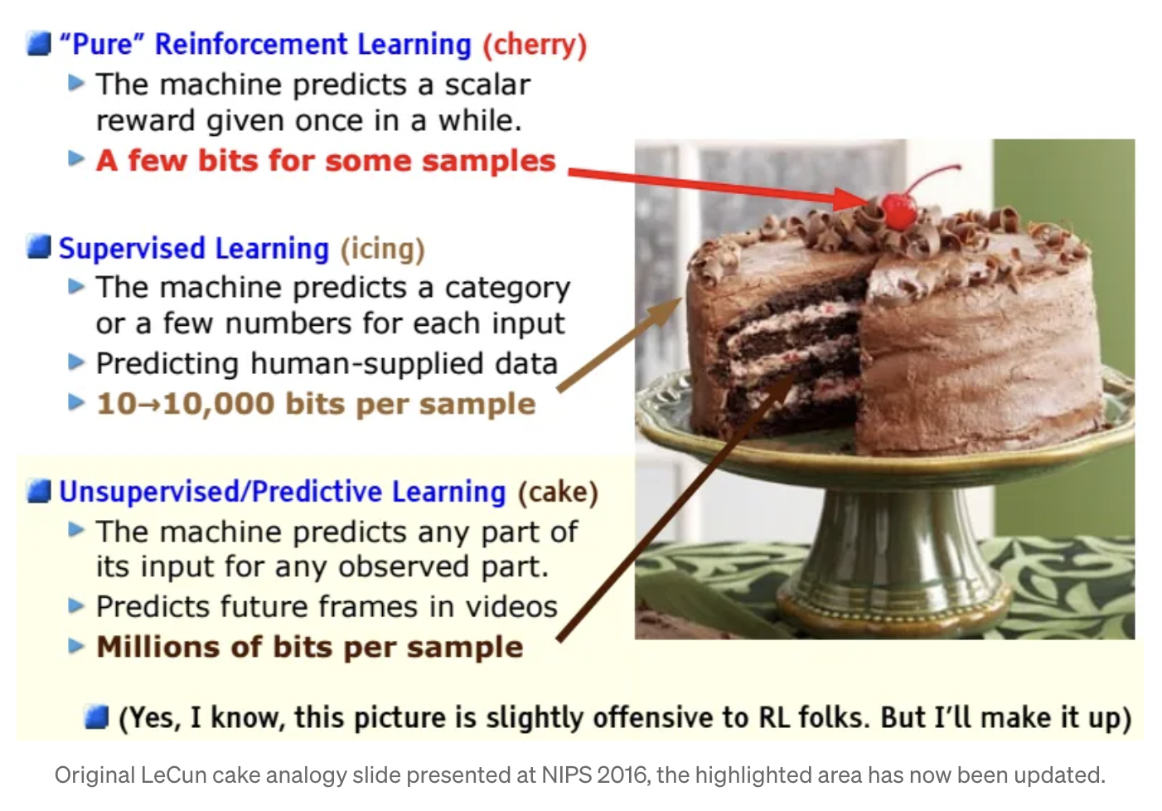
Yann LeCun’s cake analogy (NIPS/NeurIPS 2016)

Slide 7
My answer to that analogy
Only IF AI/ML is passive
Anything requires interactions, internal state changes, etc, we need LOTS of RL
Multi-agent settings
Human-AI systems
Strategic learnings
etc

Slide 8

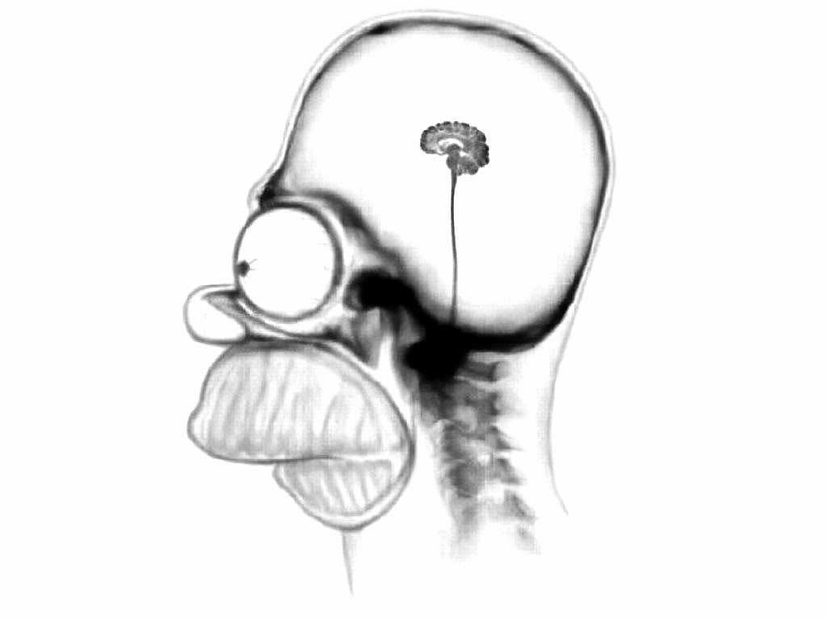

Sequential decision making in AI
Perception
Environment
Action
Perception
Classification
Update decision making policy
Update belief model
Decision making
Action

Slide 9

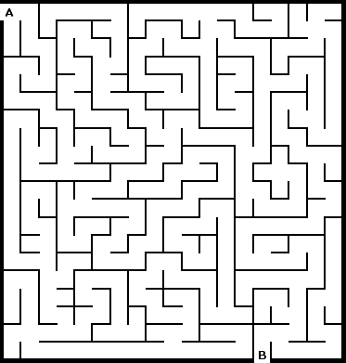
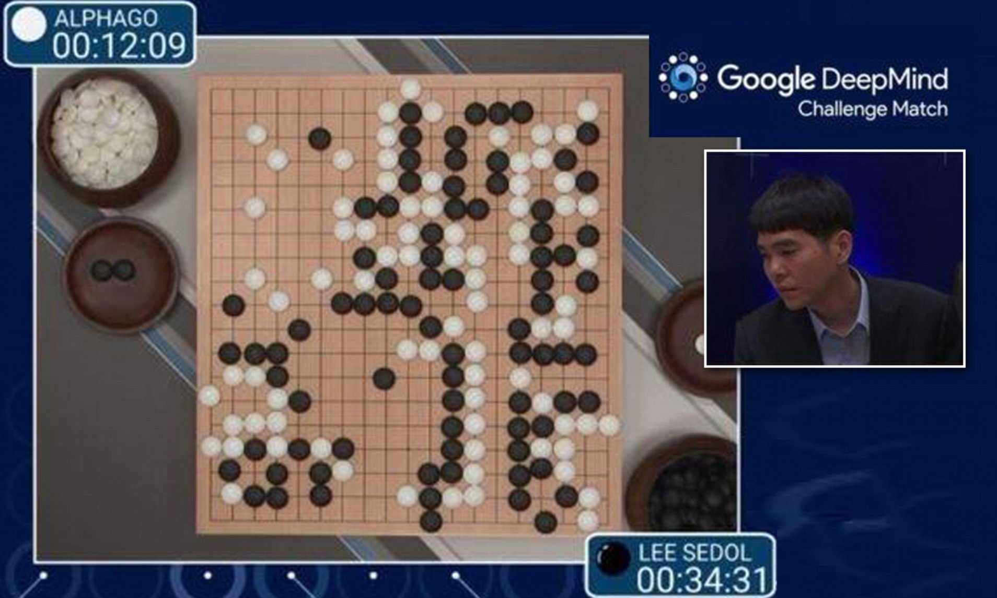
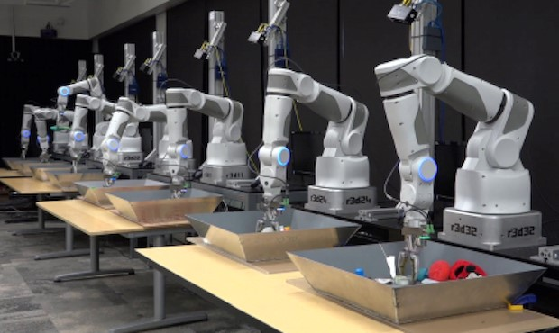
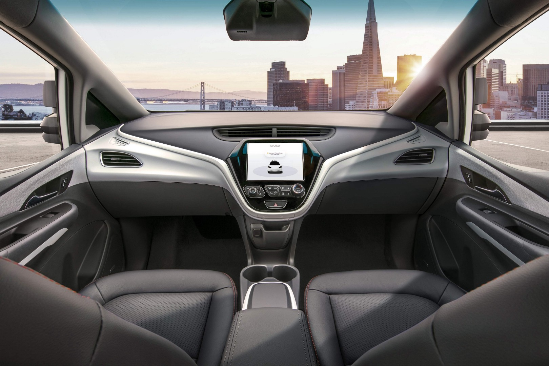
Some (real-world) examples
Source: Dailymail.co.uk
Source: Google Research
https://towardsdatascience.com/reinforcement-learning-towards-general-ai-1bd68256c72d

Slide 10
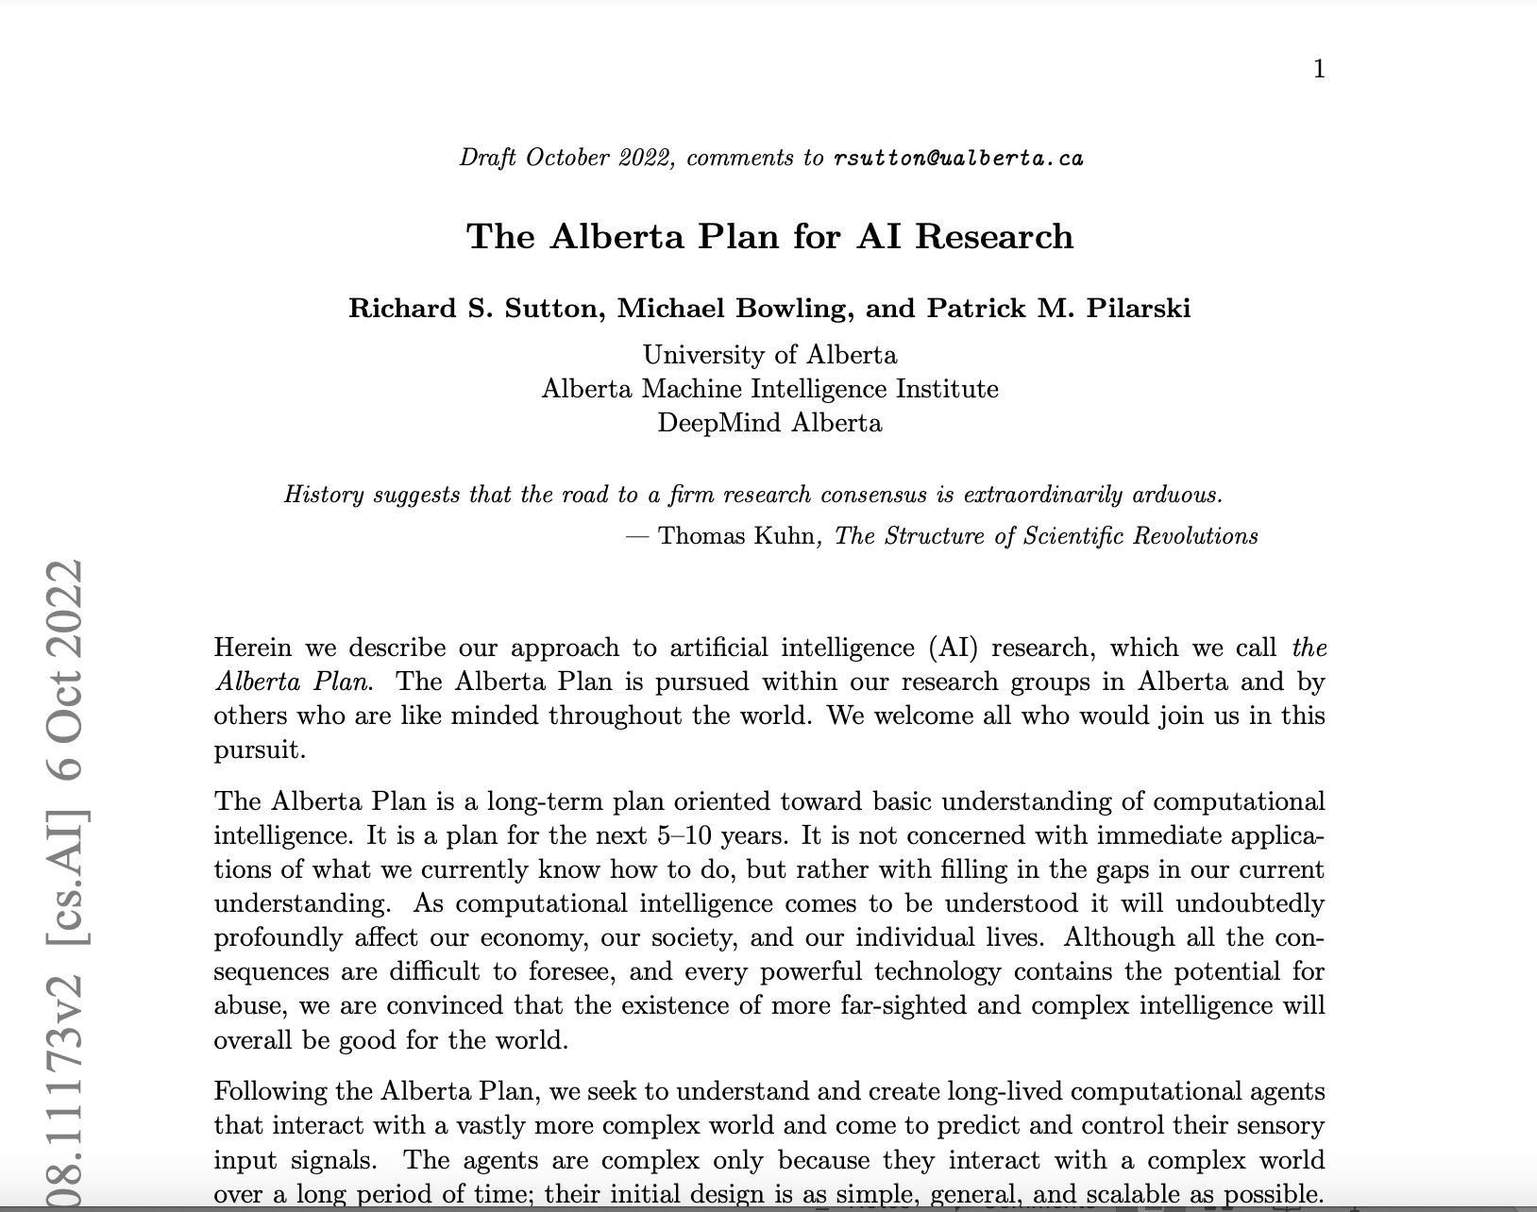

Slide 11
Markov Decision Processes

Slide 12
Agent + environment
Perception
Environment
Action
Abstract model:
Agent
Environment
Set of decision/action options (action set)
Repeatedly choose actions (discrete time steps)
Actions typically change environment’s state
Receive feedback info (new state, usefulness of action, etc)

Slide 13
Markov process (Markov chain)
S_t
S_(t+1)
S_(t+2)
State:
History:
Markov property:

Slide 14
Markov reward process (MRP)
S_t
S_(t+1)
S_(t+2)
r_t
r_(t+1)
r_(t+2)
State:
History:
Markov property:
Receive (random) reward:
Reward function:

Slide 15
Markov reward process (MRP)
S_t
S_(t+1)
S_(t+2)
r_t
r_(t+1)
r_(t+2)
State:
History:
Markov property:
Receive (random) reward:
Reward function:
Return value: where is a discount factor
If rewards are bounded -> return is also bounded (we assume it’s bounded)
State value function:
Horizon T: can be finite or infinite

Slide 16
Markov reward process (MRP)
How to calculate V(s)?

Slide 17
Markov reward process (MRP)
Law of total expectation
How to calculate V(s)?
Markov property

Slide 18
Markov reward process (MRP)
How to calculate V(s)?
Immediate reward
Discounted sum of future rewards
This is called the Bellman equation

Slide 19
Markov reward process (MRP)
How to calculate V(s)?
Vector format:
Analytical solution:
Quite slow (requires calculation of matrix inverse ~ O(|S|^3))
Inverse might not exist

Slide 20
Markov reward process (MRP)
Calculating V(s) with dynamic programming:
Initialisation:
For k = 1 until convergence do:
Computational complexity per round: O(|S|^2)

Slide 21
Markov decision process (MDP)
a_t
a_(t+1)
a_(t+2)
S_t
S_(t+1)
S_(t+2)
r_t
r_(t+1)
r_(t+2)
MDP = MRP + actions
At each t: take action
Markovian transition probability:
Reward function:
Discount factor:
MDP is tuple

Slide 22
MDP policies
a_t
a_(t+1)
a_(t+2)
S_t
S_(t+1)
S_(t+2)
r_t
r_(t+1)
r_(t+2)
A policy specifies which action to take at each state s
Deterministic vs. stochastic policy
Formal definition:

Slide 23
MDP policies
a_t
a_(t+1)
a_(t+2)
S_t
S_(t+1)
S_(t+2)
r_t
r_(t+1)
r_(t+2)
A policy specifies which action to take at each state s
Deterministic vs. stochastic policy
Formal definition:
MDP + policy = MRP
Reward function:
State transition probability:

Slide 24
MDP policies
a_t
a_(t+1)
a_(t+2)
S_t
S_(t+1)
S_(t+2)
r_t
r_(t+1)
r_(t+2)
A policy specifies which action to take at each state s
Deterministic vs. stochastic policy
Formal definition:
MDP + policy = MRP
Reward function:
State transition probability:
Evaluating the value of a policy in MDPs = computing the value of a MRP

Slide 25
MDP policy value evaluation
Calculating V(s) with dynamic programming:
Initialisation:
For k = 1 until convergence do:

Slide 26
MDP policy value evaluation
Calculating V(s) with dynamic programming:
Initialisation:
For k = 1 until convergence do:
This is called the Bellman backup/update operator for a particular policy

Slide 27
MDP policy value evaluation
Why dynamic programming solution will converge?
Bellman backup/update operator is a contraction operator:
It’s easy to show that
This implies that for rounds (k-1), k, and (k+1) in DP:
This will converge to 0 if -> DP converges in finite iterations (bounded sequence with decreasing differences)

Slide 28
From evaluating a policy to computing the optimal policy
Optimal policy:
Claim 1: If there exists an optimal policy with optimal V*, then there also exists a deterministic policy with the same V* state value function
Claim 2: There exists such optimal policy

Slide 29
From evaluating a policy to computing the optimal policy
Optimal policy:
Claim 1: If there exists an optimal policy with optimal V*, then there also exists a deterministic policy with the same V* state value function
Claim 2: There exists such optimal policy
Proof sketch of Claim1:
Any randomised policy = linear combination of deterministic policies. In fact, it lies within the convex hull of those deterministic policies
If a randomised policy is optimal, so at least one of its deterministic supports

Slide 30
From evaluating a policy to computing the optimal policy
Optimal policy:
Claim 1: If there exists an optimal policy with optimal V*, then there also exists a deterministic policy with the same V* state value function
Claim 2: There exists such optimal policy
Proof sketch of Claim1:
Any randomised policy = linear combination of deterministic policies. In fact, it lies within the convex hull of those deterministic policies
If a randomised policy is optimal, so at least one of its deterministic supports
Proof sketch of Claim 2:
There are finite number of deterministic policies (hence argmax does exist)
Homework (optional): Proof these claims in a technically rigorous way

Slide 31
Computing the optimal policy
Key implication: we can just focus on deterministic policies

Slide 32
Computing the optimal policy
Key implication: we can just focus on deterministic policies
However, the set of these policies is exponentially large:
Therefore we need better solution than exhaustive search (enumeration)

Slide 33
Policy iteration (PI)
We focus on deterministic policies
Set i = 0
Initialise randomly for all state s
While do:
Evaluate value function of
Improve policy into

Slide 34
Policy iteration (PI)
We focus on deterministic policies
Set i = 0
Initialise randomly for all state s
While do:
Evaluate value function of
Improve policy into

Slide 35
State-action value (Q value)
Consider the value of a state-action pair:

Slide 36
State-action value (Q value)
Consider the value of a state-action pair:
Meaning: the value of taking action a now, then follow policy in the future

Slide 37
Back to PI
Compute the state-action value of policy for each (s,a) pair :
Now, the policy improvement step:

Slide 38
Back to PI
Compute the state-action value of policy for each (s,a) pair :
Now, the policy improvement step:
Statement: this policy iteration method will find the optimal policy in finite number of iterations

Slide 39
Back to PI
Compute the state-action value of policy for each (s,a) pair :
Now, the policy improvement step:
Statement: this policy iteration method will find the optimal policy in finite number of iterations
Proof sketch:
The new policy is also deterministic (max_a is deterministic)
At least as good as the previous policy (use some simple algebra)
Finite number of deterministic policies -> will stop changing (recall Claim 2 on slide 26)
Once it converges, the final policy is optimal (proof by contradiction)
Homework 2 (optional): Proof these claims in the proof sketch

Slide 40
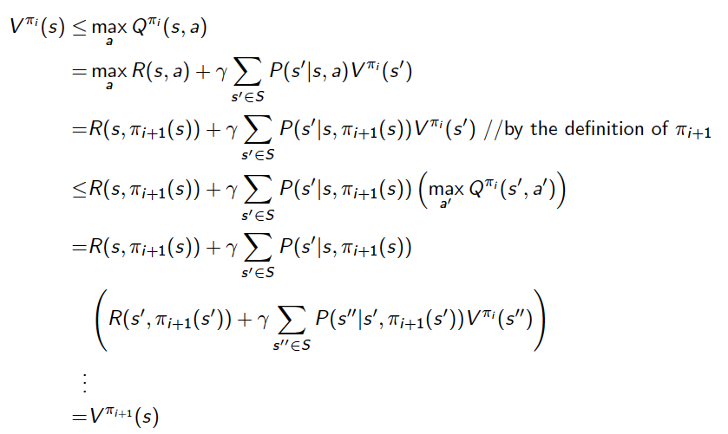
Hint: At least as good as the previous policy – taken from E. Brunskill’s lecture slides (Stanford)

Slide 41
Computing the optimal value function
Value iteration (high level idea):
Consider episodes of finite time horizon H
Maintain optimal value of starting in a state s with k time steps left until H (episode)
Iterate to consider longer and longer episodes until k = H

Slide 42
Computing the optimal value function
Value iteration (high level idea):
Consider episodes of finite time horizon H
Maintain optimal value of starting in a state s with k time steps left until H (episode)
Iterate to consider longer and longer episodes until k = H
Recall that a value function of a policy must satisfy the Bellman equation:

Slide 43
Computing the optimal value function
Value iteration (high level idea):
Consider episodes of finite time horizon H
Maintain optimal value of starting in a state s with k time steps left until H (episode)
Iterate to consider longer and longer episodes until k = H
Recall that a value function of a policy must satisfy the Bellman equation:
Bellman equation for the optimal value function:

Slide 44
Dynamic programming for value iteration
Optimal value function up to k more time steps:
Optimal policy up to k more time steps:
Initialise
For k = 1 to H (H is the final horizon)

Slide 45
Value iteration vs. Policy iteration
Value iteration:
Compute optimal value for horizon k <= H
Note this can be used to compute optimal policy of horizon k <= H
Increment k until H
Policy iteration
Compute infinite horizon value of a policy
Use to select another (better) policy
Closely related to a very popular method in RL: policy gradient (later)

